Slide 1

FREE
THINKER

Slide 2


Team Members
Group -3

Slide 3
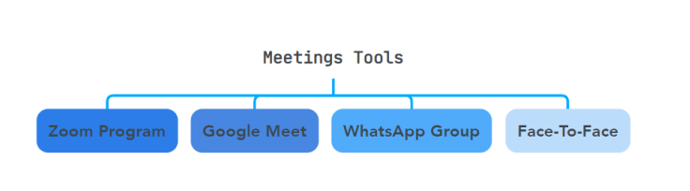
Team Meetings

Slide 4
Project Description
The human resources system project aims to manage the operations related to employees within an institution or company in terms of registering employee attendance, submitting requests for leaves, vacations, and remote work.as well as some secondary features such as viewing the calendar and viewing the balance of leaves and departures.
This system also enables the manager or human resources employee to produce reports specific to each employee, such as reports of the employee’s attendance, vacations balance,leaves balance .

Slide 5

Functional Requirements
Attendance Recording
Send Leave Request
Attendance recorded via iris/fingerprint,card backup available.
Submit leave requests,HR reviews and responds.
Send Remote Work Request
Employee leave and Vacation History
Submit remote work request, manager approves or rejects.
Employees access historical leave records.
Send Vacation Request
Employee’s Calendar View
Request and review vacation time; HR decision communicated.
Personal calendar with tracking of vacation types.

Slide 6
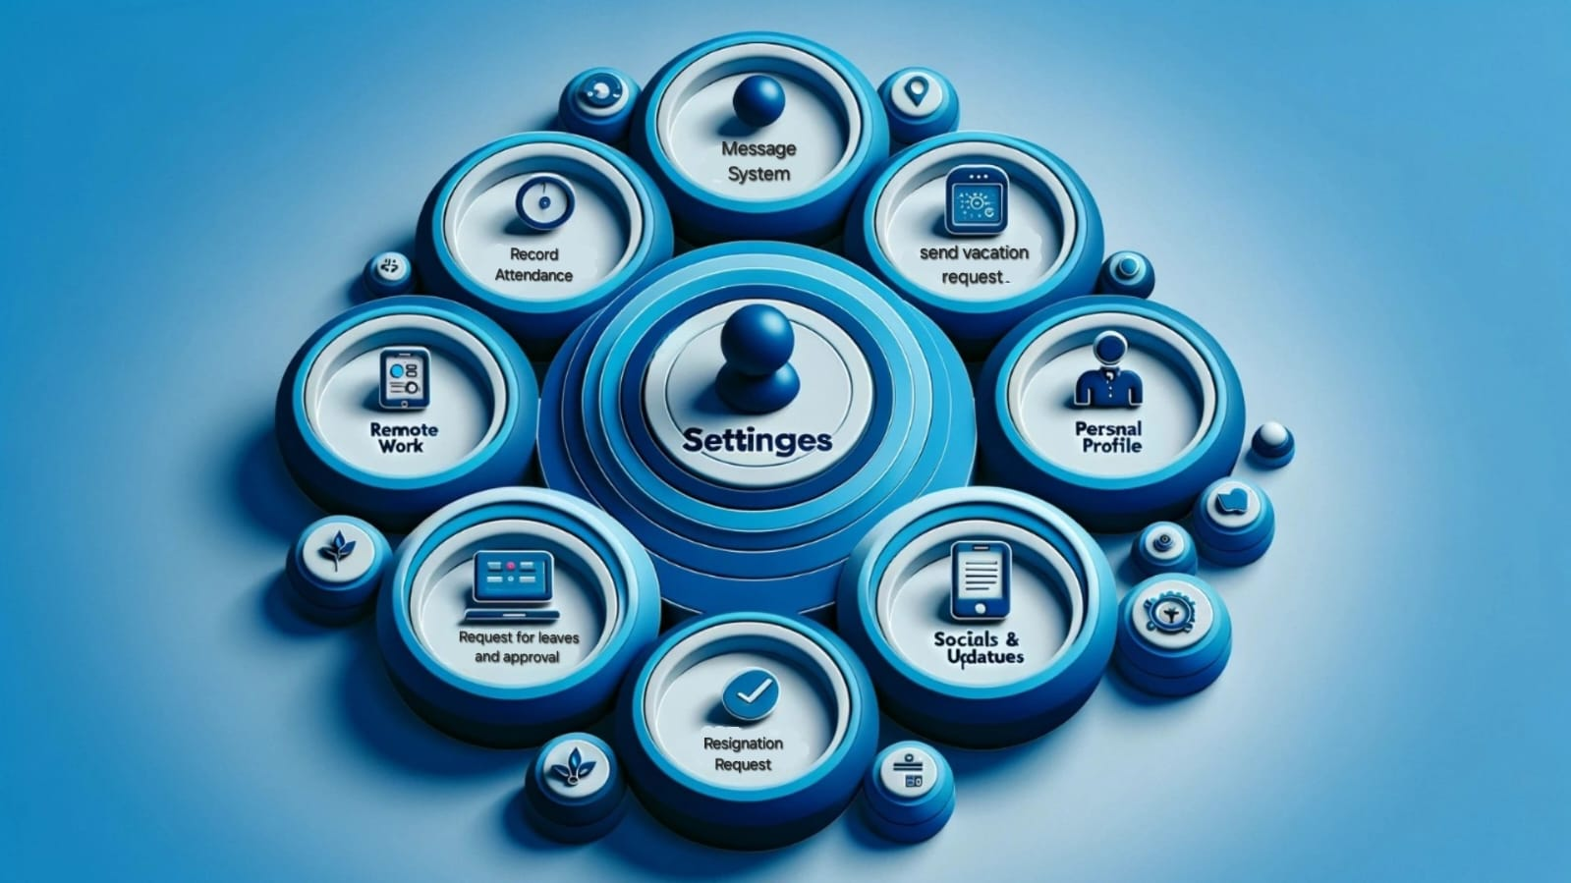
Functional
Requirements

Slide 7
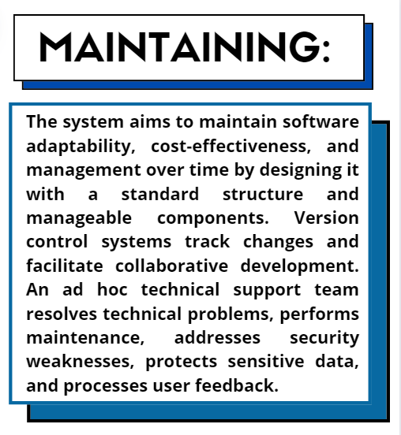
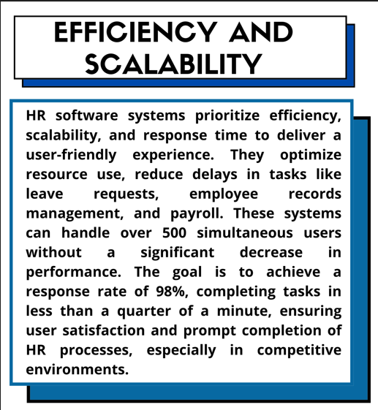
_______________________________
Non-Functional Requirements

Slide 8
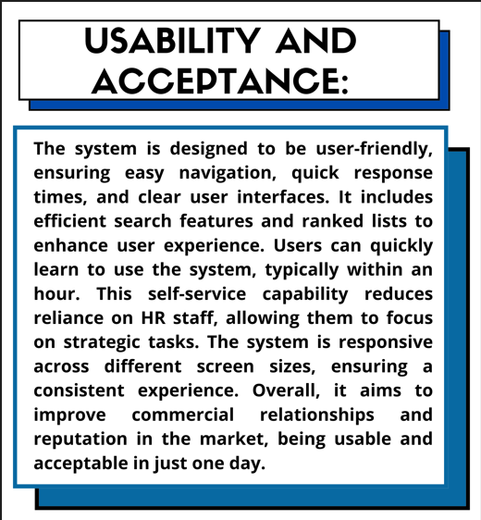
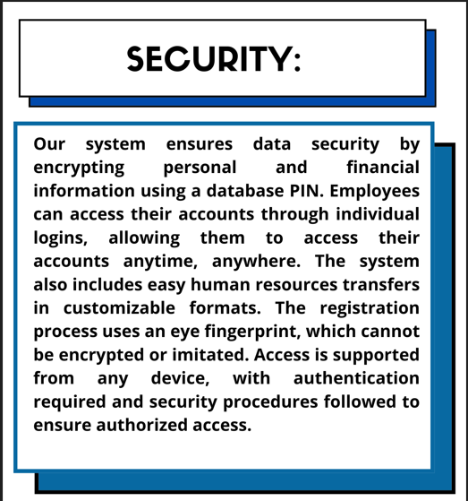
_______________________________
Non-Functional Requirements

Slide 9
Software Development Process
The incremental software development process will be employed in this project due to the possibility of changing the project's needs over time and the potential for a clearer project vision to emerge.
The customer remains in constant contact with the company that designs the system, and therefore if the customer wants to modify something, he can modify it from the beginning, and this does not cost the company time or effort.

Slide 10
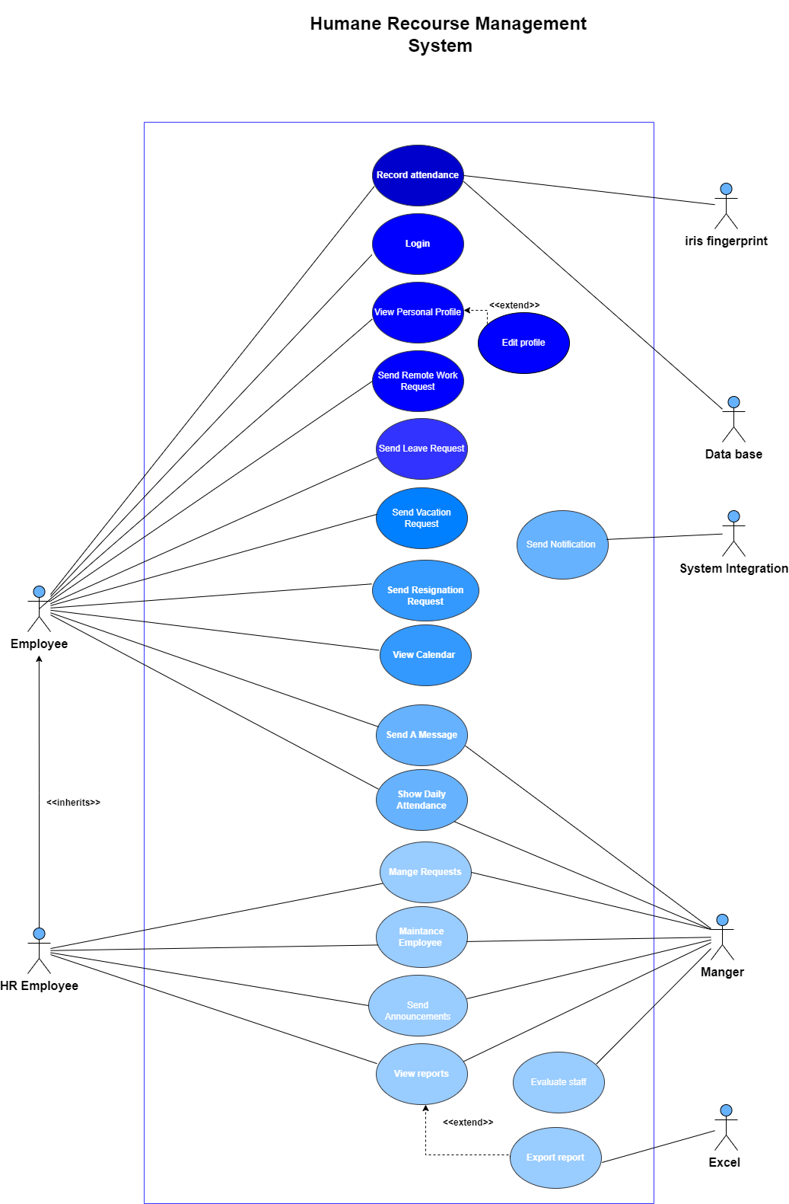
Use Case Diagram

Slide 11
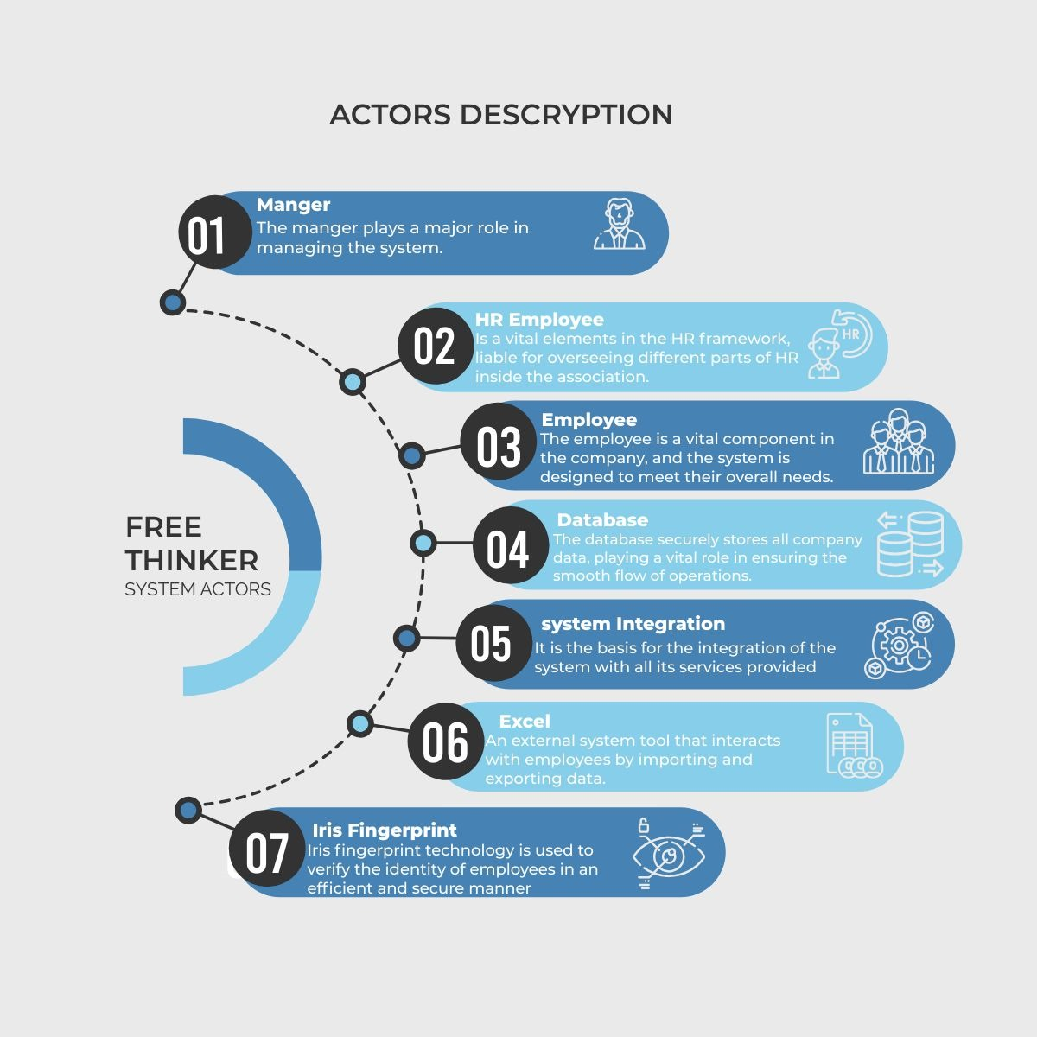
Actors

Slide 12
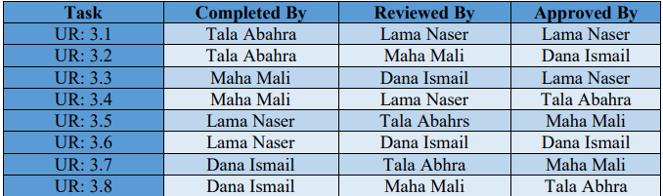
User and System Requirements
(UR 3.1) Attendance Recording
(UR 3.2) Show Daily Attendance
(UR 3.3) Work Remotely
(UR 3.4) Manage Request
(UR 3.5) Request A Vacation
(UR 3.6) View Personal Profile
(UR 3.7) Login to the System
(UR 3.8) Maintenance Employee

Slide 13
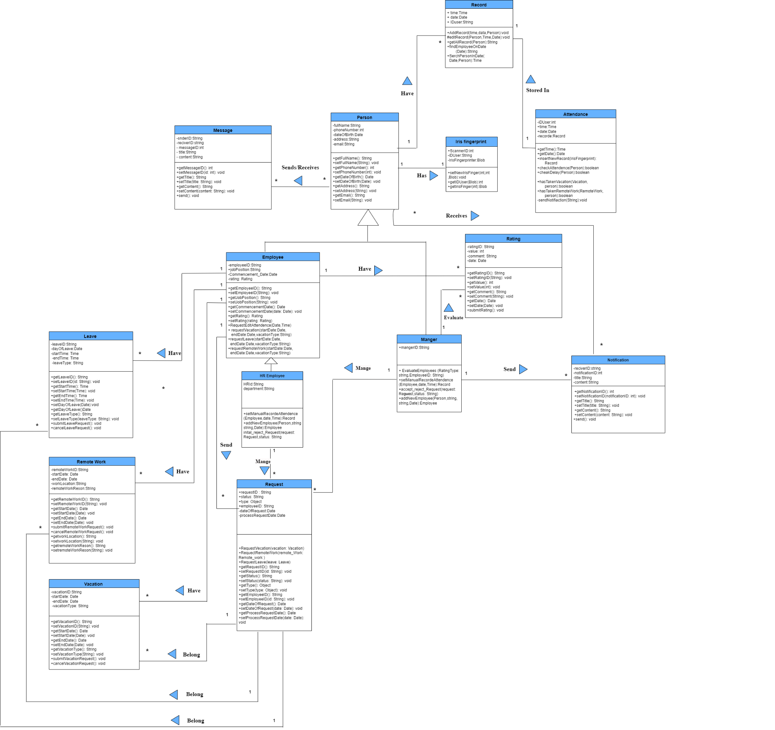
Class Diagram

Slide 14
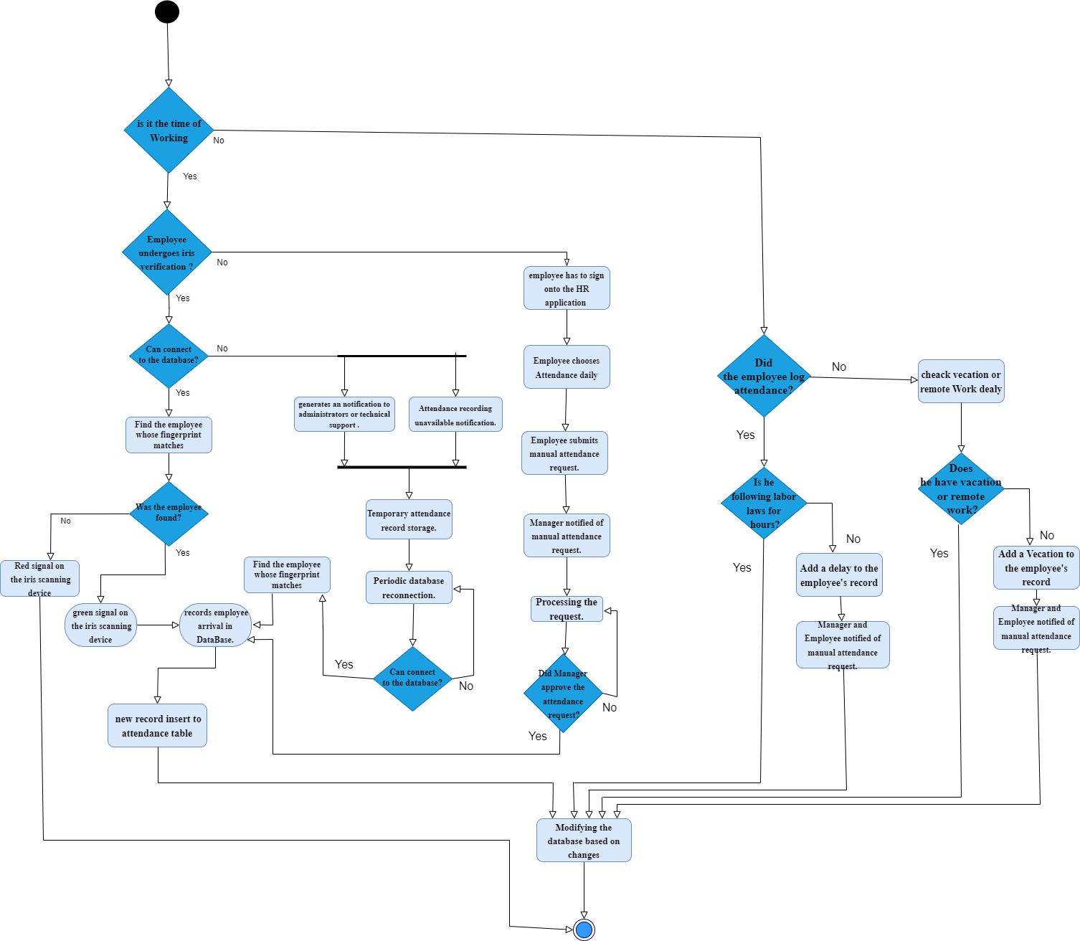
Activity Diagram
Attendance Record

Slide 15
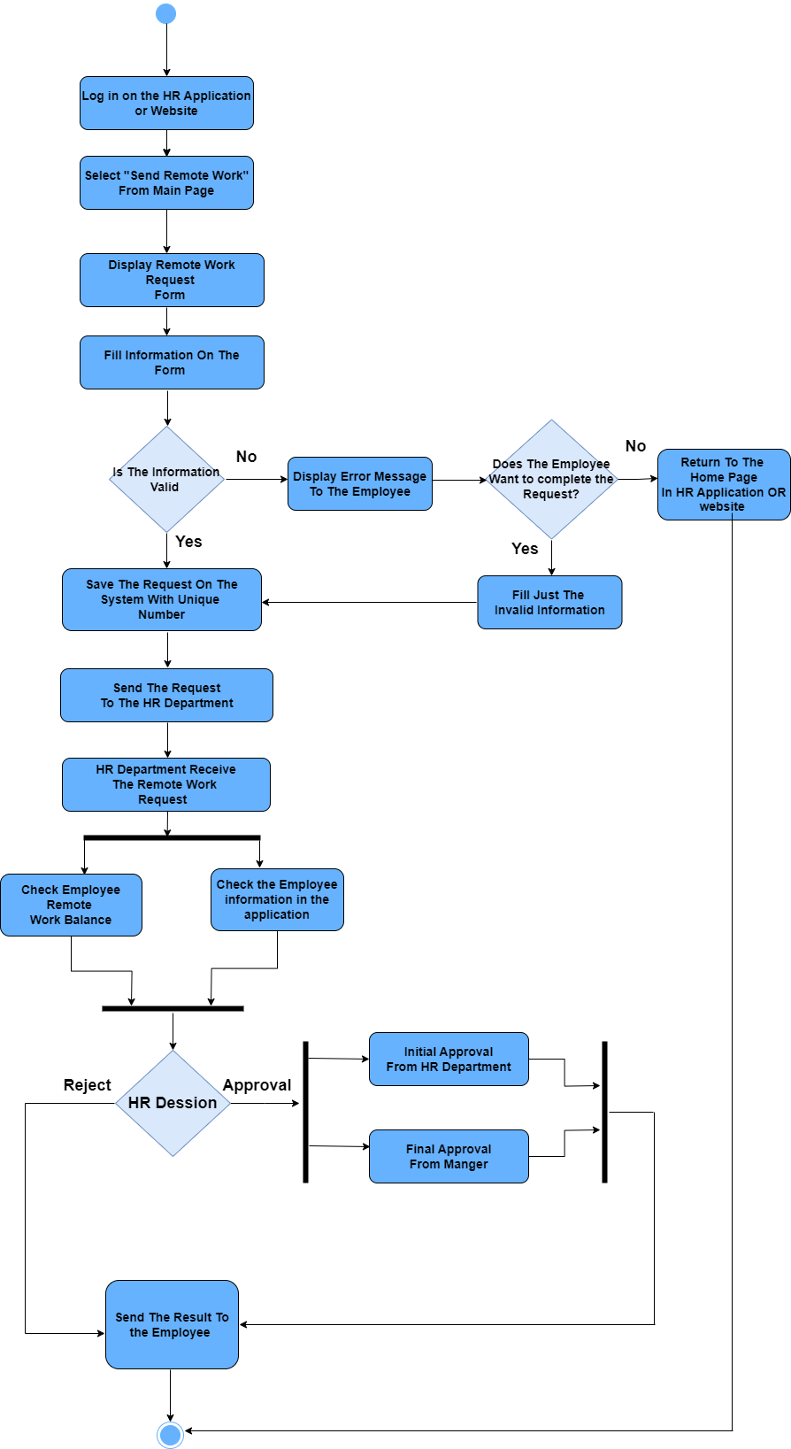
Send Remote
Work Request

Slide 16
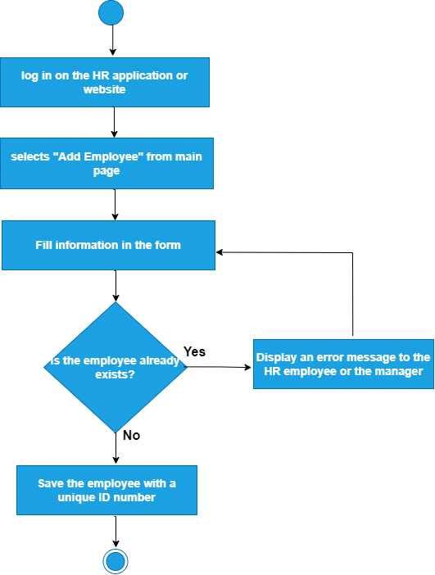
Add Employee

Slide 17
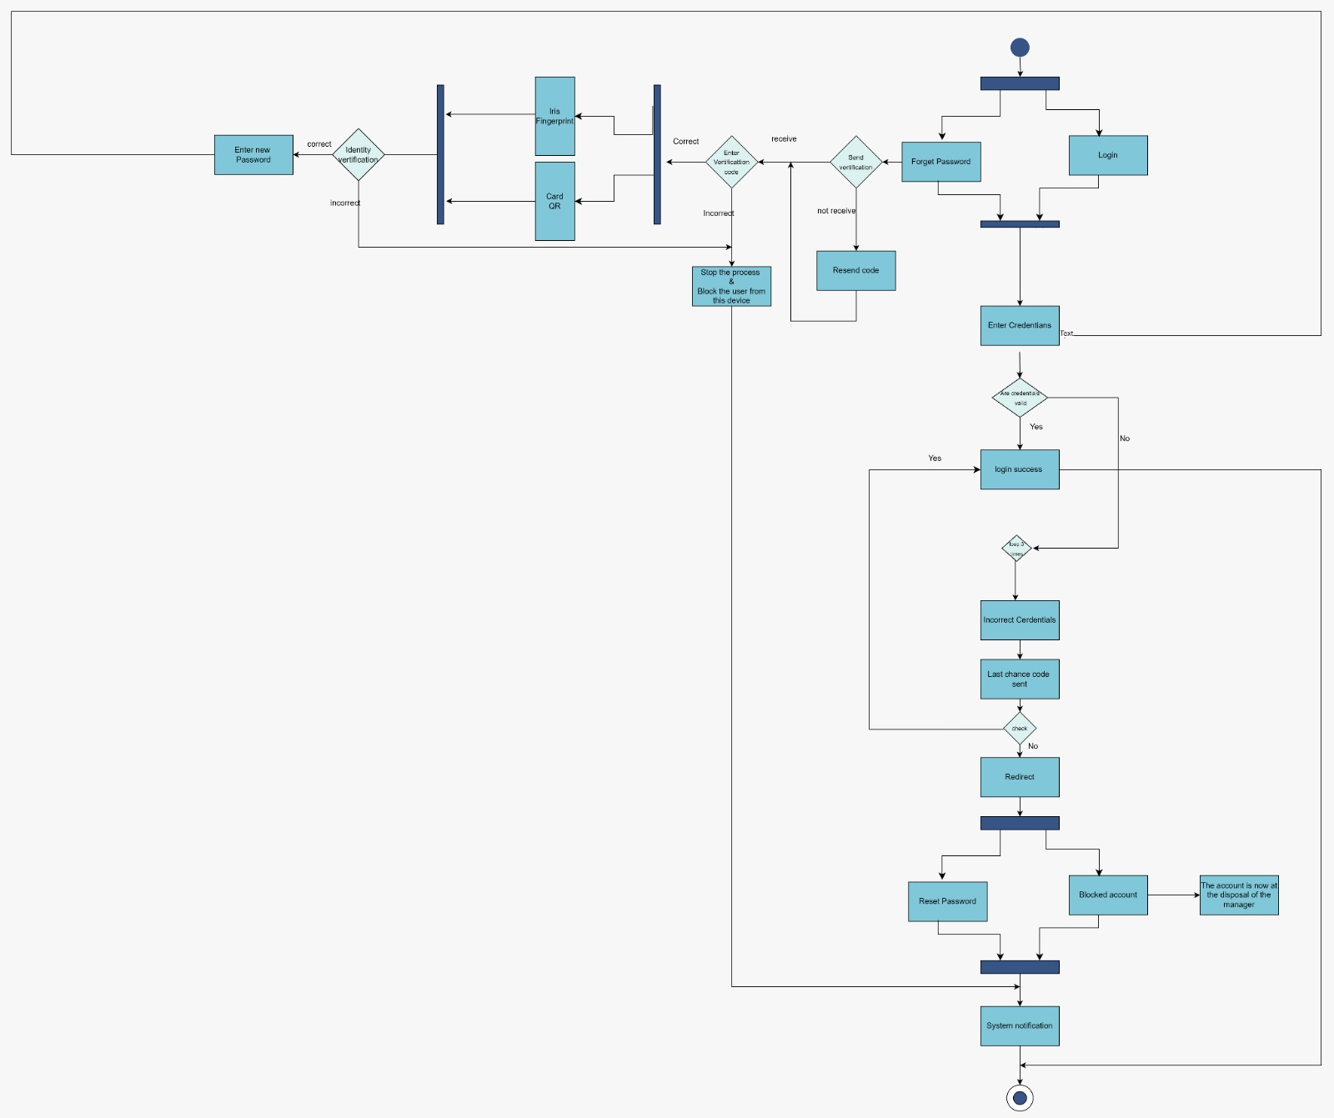
Login

Slide 18
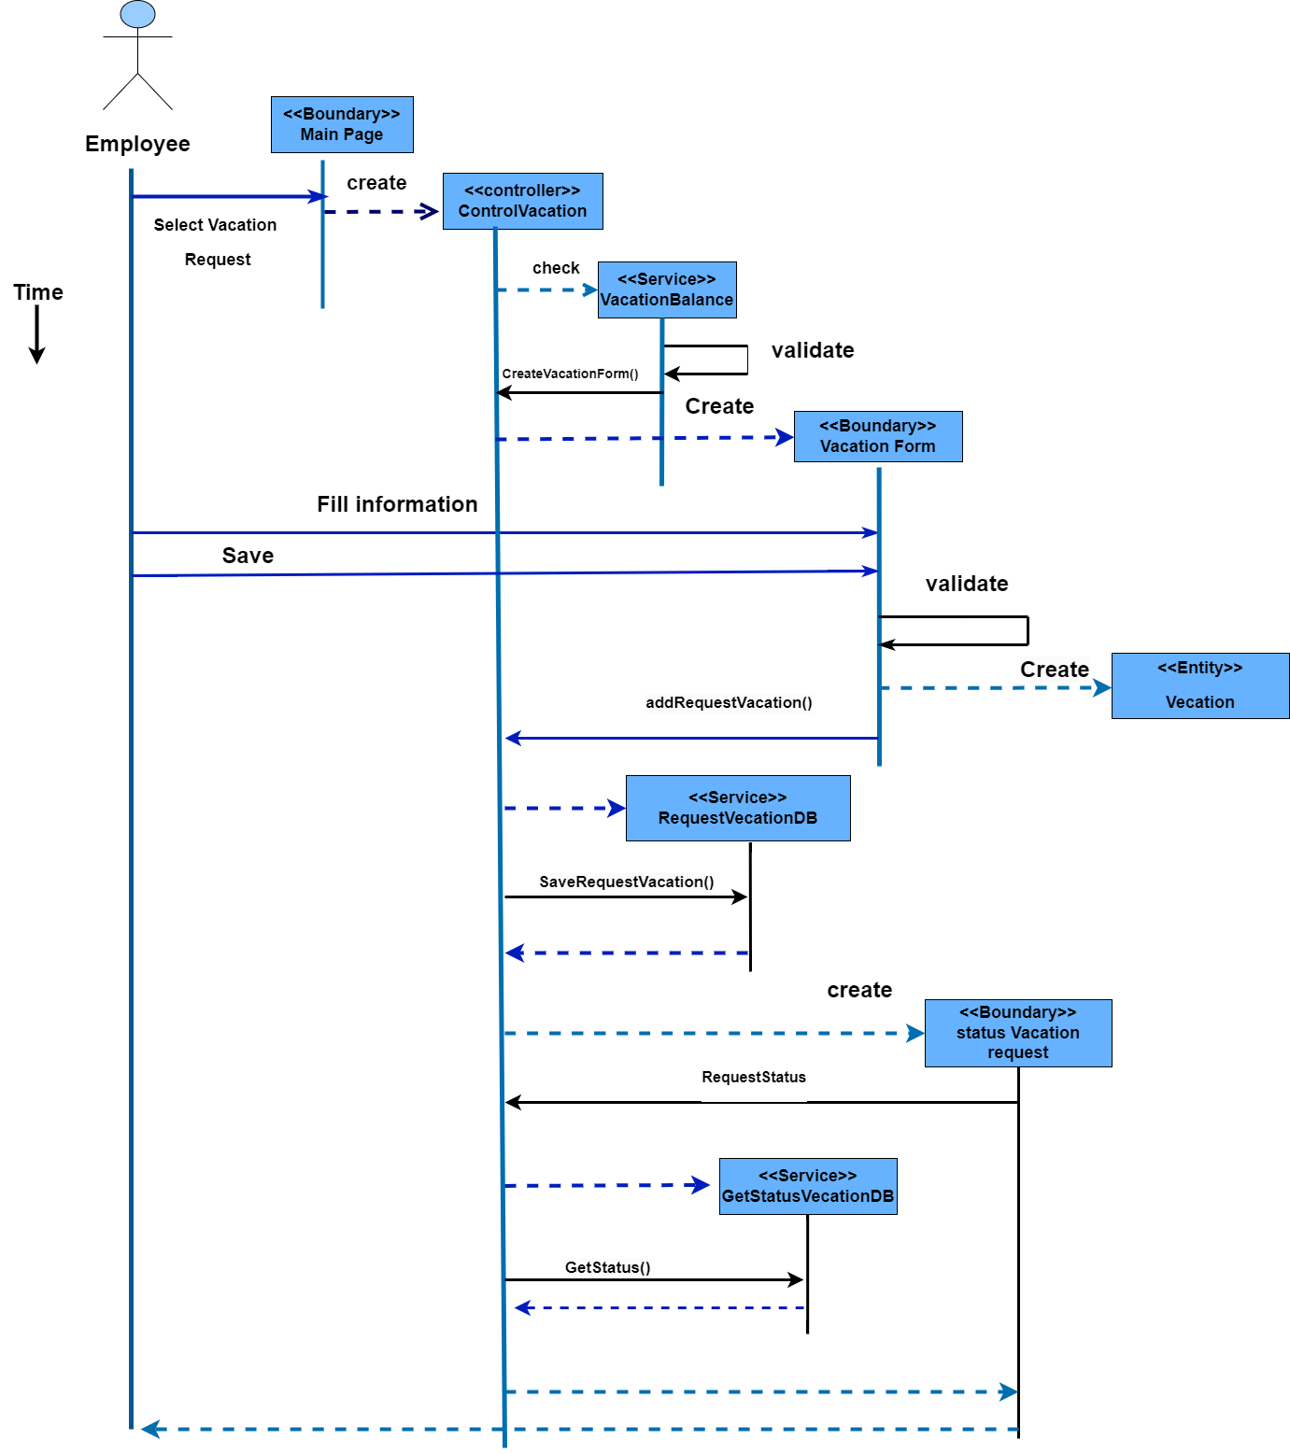
Sequence
Diagram

